Slide 1
Data-Centric Consistency Models
School Of Computer Engineering, KIIT DU

Slide 2
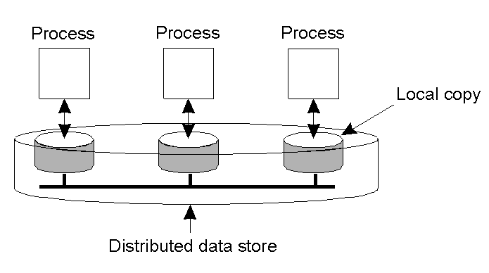
Data-Centric Consistency Models
A data-store can be read from or written to by any process in a distributed system.
A local copy of the data-store (replica) can support “fast reads”.
However, a write to a local replica needs to be propagated to all remote replicas.
Various consistency models help to understand the various mechanisms used to achieve and enable this.

Slide 3
What is a Consistency Model?
A “consistency model” is a CONTRACT between a DS (data-store) and its processes.
If the processes agree to the rules, the data-store will perform properly and as advertised.
We start with Strict Consistency, which is defined as:
Any read on a data item ‘x’ returns a value corresponding to the result of the most recent write on ‘x’ (regardless of where the write occurred).

Slide 4
Consistency Model Diagram Notation
W_{i}(x)a – a write by process ‘i’ to item ‘x’ with a value of ‘a’. That is, ‘x’ is set to ‘a’.
(Note: The process is often shown as ‘P_{i}’).
R_{i}(x)b – a read by process ‘i’ from item ‘x’ producing the value ‘b’. That is, reading ‘x’ returns ‘b’.
Time moves from left to right in all diagrams.

Slide 5

Strict Consistency Diagrams
Behavior of two processes, operating on the same data item:
A strictly consistent data-store.
A data-store that is not strictly consistent.
With Strict Consistency, all writes are instantaneously visible to all processes and absolute global time order is maintained throughout the DS. This is the consistency model “Holy Grail” – not at all easy in the real world, and all but impossible within a DS.
So, other, less strict (or “weaker”) models have been developed …

Slide 6
Sequential Consistency
A weaker consistency model, which represents a relaxation of the rules.
It is also must easier (possible) to implement.
Definition of “Sequential Consistency”:
The result of any execution is the same as if the (read and write) operations by all processes on the data-store were executed in the same sequential order and the operations of each individual process appear in this sequence in the order specified by its program.

Slide 7
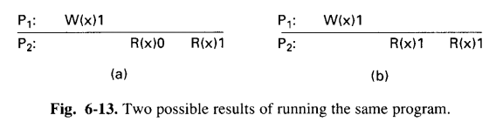
Sequential Consistency Diagrams
In other words: all processes see the same interleaving set of operations, regardless of what that interleaving is.
A memory behaving as shown in Fig. (a) is sequentially consistent even though the first read done by P2 returns the initial value of 0 instead of the new value of 1.
Sequentially consistent memory does not gurantee that a read returns a value written by another process a NS earlier, a MS earlier, or even a minute earlier. It merely gurantees that all processes see all memory references in the same order. If the program generated in Fig. (a) is run again, it might give the result of Fig. (b).

Slide 8
Problem with Sequential Consistency
With this consistency model, adjusting the protocol to favour reads over writes (or vice-versa) can have a devastating impact on performance.
For this reason, other weaker consistency models have been proposed and developed.
Again, a relaxation of the rules allows for these weaker models to make sense.

Slide 9
Linearizability and Sequential Consistency (1)
Process P1 | Process P2 | Process P3
x = 1; print ( y, z); | y = 1; print (x, z); | z = 1; print (x, y);
Three concurrently executing processes.

Slide 10
Linearizability and Sequential Consistency (2)
Four valid execution sequences for the processes of the previous slide. The vertical axis is time.
x = 1; print ((y, z); y = 1; print (x, z); z = 1; print (x, y); Prints: 001011 Signature: 001011 (a) | x = 1; y = 1; print (x,z); print(y, z); z = 1; print (x, y); Prints: 101011 Signature: 101011 (b) | y = 1; z = 1; print (x, y); print (x, z); x = 1; print (y, z); Prints: 010111 Signature: 110101 (c) | y = 1; x = 1; z = 1; print (x, z); print (y, z); print (x, y); Prints: 111111 Signature: 111111 (d)
But, for instance, 001001 is not allowed.

Slide 11
Causal Consistency
This model distinguishes between events that are “causally related” and those that are not.
If event B is caused or influenced by an earlier event A, then causal consistency requires that every other process see event A, then event B.
Operations that are not causally related are said to be concurrent.

Slide 12

More on Causal Consistency
A causally consistent data-store obeys this condition:
Writes that are potentially causally related must be seen by all processes in the same order. Concurrent writes may be seen in a different order on different machines (i.e., by different processes).
This sequence is allowed with a causally-consistent store, but not with sequentially or strictly consistent store.
Note: It is assumed that W₂(x)b and W₁(x)c are concurrent, so it is not required that all processes see them in the same order.

Slide 13
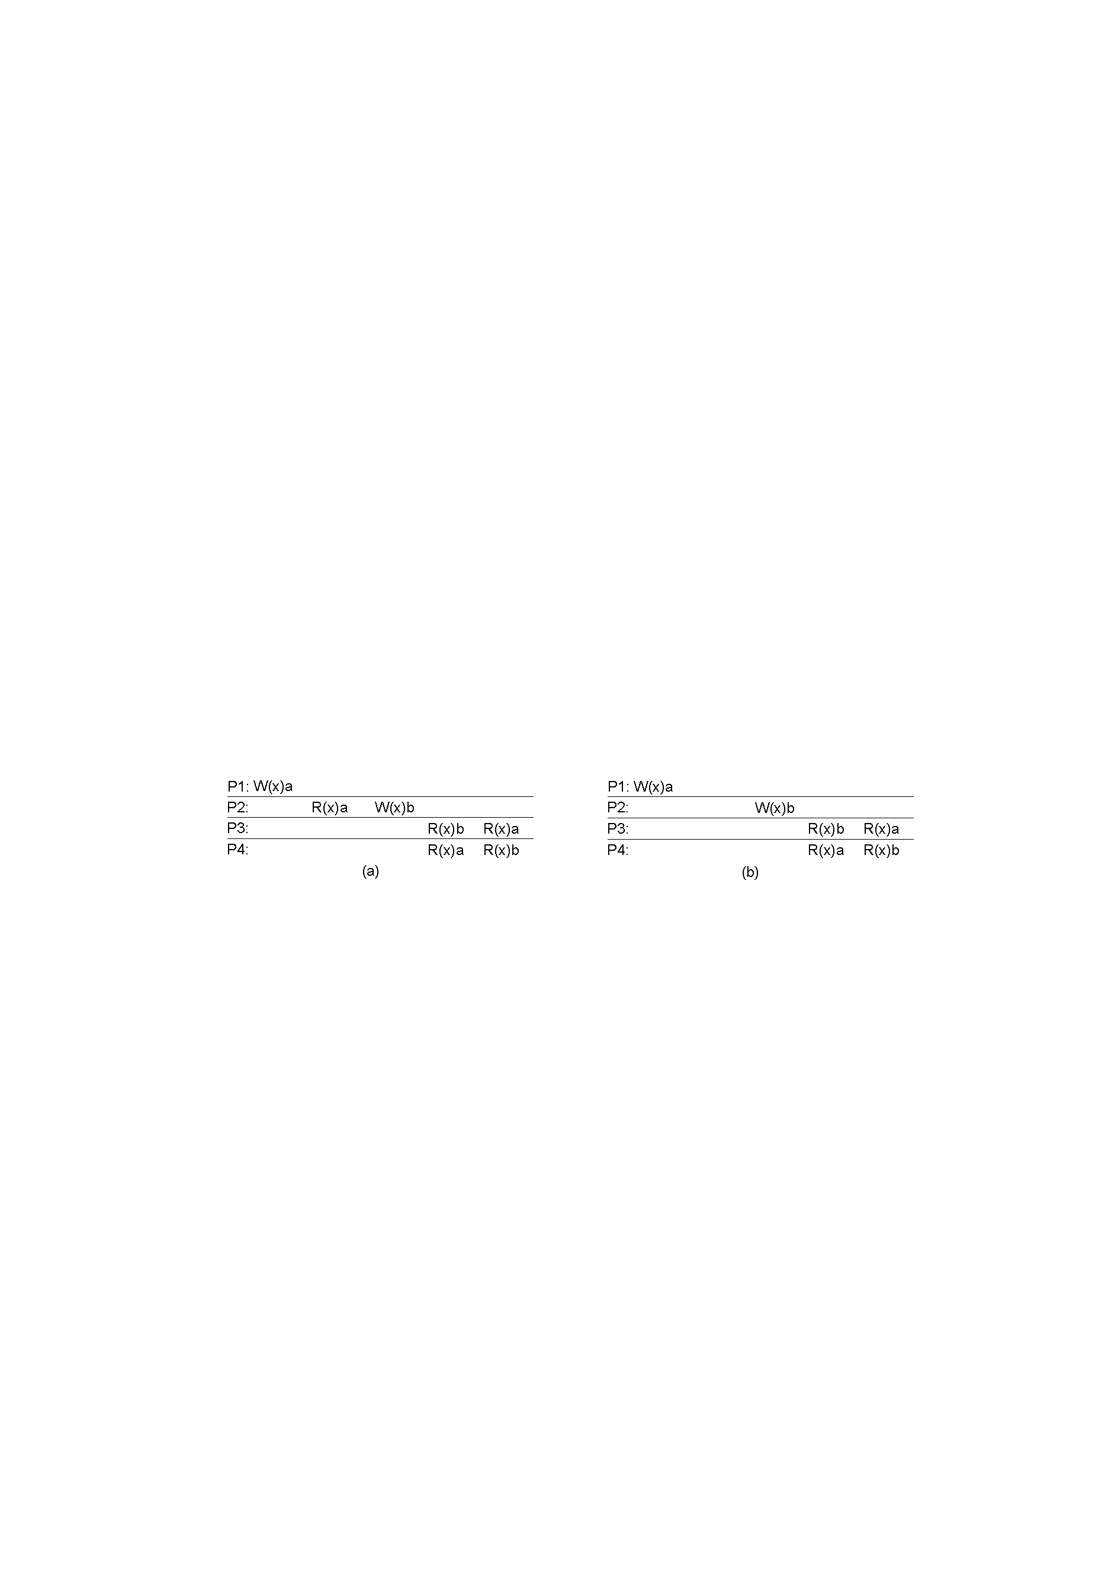
Another Causal Consistency Example
incorrect
correct
Violation of causal-consistency – P2’s write is related to P1’s write due to the read on ‘x’ giving ‘a’ (all processes must see them in the same order).
A causally-consistent data-store: the read has been removed, so the two writes are now concurrent. The reads by P3 and P4 are now OK.

Slide 14
FIFO Consistency
Defined as follows:
Writes done by a single process are seen by all other processes in the order in which they were issued, but writes from different processes may be seen in a different order by different processes.
This is also called “PRAM Consistency” – Pipelined RAM.
The attractive characteristic of FIFO is that it is easy to implement. There are no guarantees about the order in which different processes see writes – except that two or more writes from a single process must be seen in order.

Slide 15

FIFO Consistency Example
A valid sequence of FIFO consistency events.
Note that none of the consistency models studied so far would allow this sequence of events.

Slide 16
Introducing Weak Consistency
Weak consistency in distributed systems refers to a model where updates to a system may not be immediately visible to all nodes or clients. In contrast to strong consistency, which ensures that all reads return the most recent write, weak consistency allows for a scenario where different nodes might return different values for the same data at the same time.
This model introduces the notion of a “synchronization variable”, which is used update all copies of the data-store.

Slide 17
Weak Consistency Properties
The three properties of Weak Consistency:
Accesses to synchronization variables associated with a data-store are sequentially consistent.
No operation on a synchronization variable is allowed to be performed until all previous writes have been completed everywhere.
No read or write operation on data items are allowed to be performed until all previous operations to synchronization variables have been performed.

Slide 18
Weak Consistency: What It Means
So …
By doing a sync., a process can force the just written value out to all the other replicas.
Also, by doing a sync., a process can be sure it’s getting the most recently written value before it reads.
In essence, the weak consistency models enforce consistency on a group of operations, as opposed to individual reads and writes (as is the case with strict, sequential, causal and FIFO consistency).

Slide 19
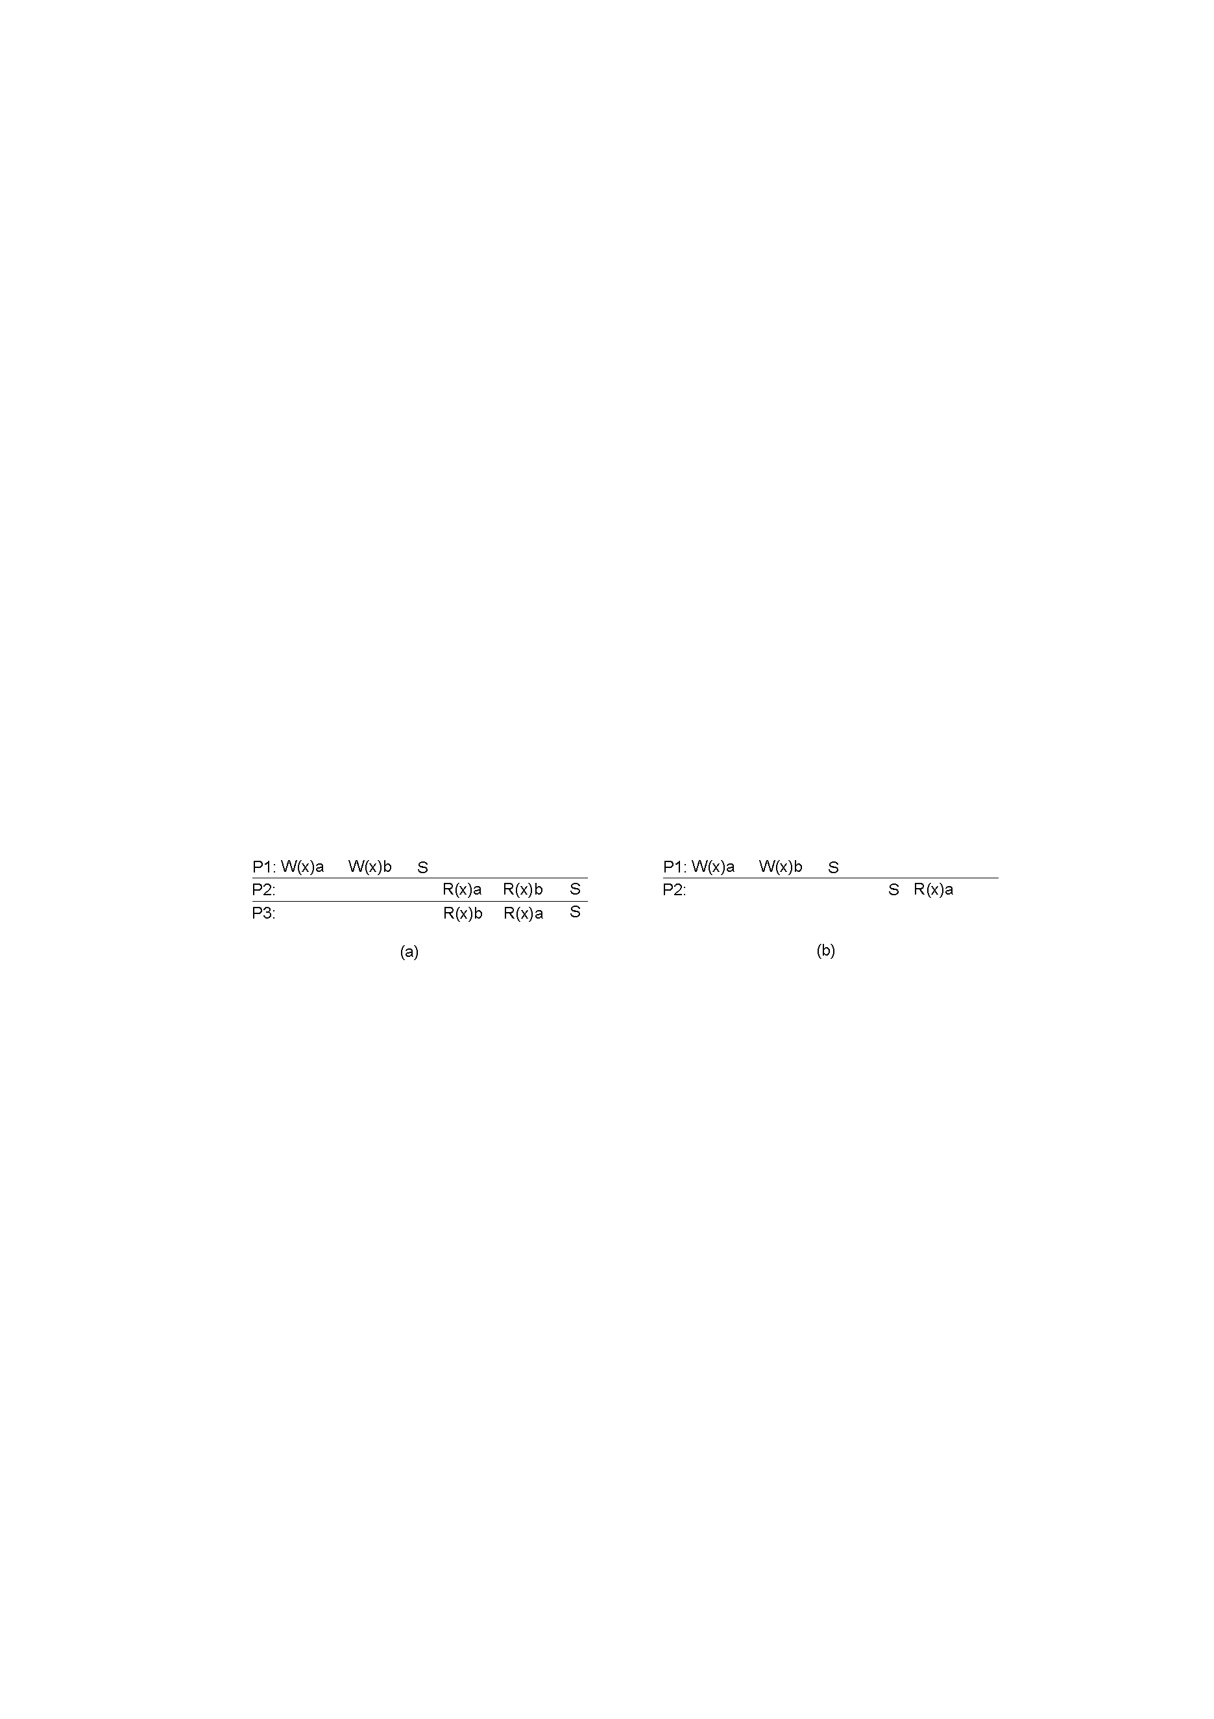
Weak Consistency Examples
before sync., any results are acceptable
Wrong!!
A valid sequence of events for weak consistency. This is because P2 and P3 have yet to synchronize, so there’s no guarantees about the value in ‘x’.
An invalid sequence for weak consistency. P2 has synchronized, so it cannot read ‘a’ from ‘x’ – it should be getting ‘b’.

Slide 20
Introducing Release Consistency
Question: how does a weakly consistent data-store know that the sync is the result of a read or a write?
Answer: It doesn’t!
It is possible to implement efficiencies if the data-store is able to determine whether the sync is a read or write.
Two sync variables can be used, “acquire” and “release”, and their use leads to the “Release Consistency” model.

Slide 21
Release Consistency
Defined as follows:
When a process does an “acquire”, the data-store will ensure that all the local copies of the protected data are brought up to date to be consistent with the remote ones if needs be.
When a “release” is done, protected data that have been changed are propagated out to the local copies of the data-store.

Slide 22

Release Consistency Example
A valid event sequence for release consistency.
Process P3 has not performed an acquire, so there are no guarantees that the read of ‘x’ is consistent. The data-store is simply not obligated to provide the correct answer.
P2 does perform an acquire, so its read of ‘x’ is consistent.

Slide 23
Release Consistency Rules
A distributed data-store is “Release Consistent” if it obeys the following rules:
Before a read or write operation on shared data is performed, all previous acquires done by the process must have completed successfully.
Before a release is allowed to be performed, all previous reads and writes by the process must have completed.
Accesses to synchronization variables are FIFO consistent (sequential consistency is not required).

Slide 24
Introducing Entry Consistency
A different twist on things is “Entry Consistency”. Acquire and release are still used, and the data-store meets the following conditions:
An acquire access of a synchronization variable is not allowed to perform with respect to a process until all updates to the guarded shared data have been performed with respect to that process.
Before an exclusive mode access to a synchronization variable by a process is allowed to perform with respect to that process, no other process may hold the synchronization variable, not even in nonexclusive mode.
After an exclusive mode access to a synchronization variable has been performed, any other process's next nonexclusive mode access to that synchronization variable may not be performed until it has performed with respect to that variable's owner.

Slide 25

Entry Consistency: What It Means
So, at an acquire, all remote changes to guarded data must be brought up to date.
Before a write to a data item, a process must ensure that no other process is trying to write at the same time.
Locks associate with individual data items, as opposed to the entire data-store. Note: P2’s read on ‘y’ returns NIL as no locks have been requested.

Slide 26
Summary of Consistency Models
Consistency models that do not use synchronization operations.
Models that do use synchronization operations. (These require additional programming constructs, and allow programmers to treat the data-store as if it is sequentially consistent, when in fact it is not. They “should” also offer the best performance).
Consistency | Description
Strict | Absolute time ordering of all shared accesses matters.
Linearizability | All processes must see all shared accesses in the same order. Accesses are furthermore ordered according to a (nonunique) global timestamp.
Sequential | All processes see all shared accesses in the same order. Accesses are not ordered in time.
Causal | All processes see causally-related shared accesses in the same order.
FIFO | All processes see writes from each other in the order they were used. Writes from different processes may not always be seen in that order.
 | (a)
Consistency | Description
Weak | Shared data can be counted on to be consistent only after a synchronization is done.
Release | Shared data are made consistent when a critical region is exited.
Entry | Shared data pertaining to a critical region are made consistent when a critical region is entered.
 | (b)

